Slide 1
Web Crawler & Request
Songyue Wang (sywang@cs.hku.hk)

Slide 2
Legal Use
Get information from 3rd party (API)
Research & Data analytics

Slide 3
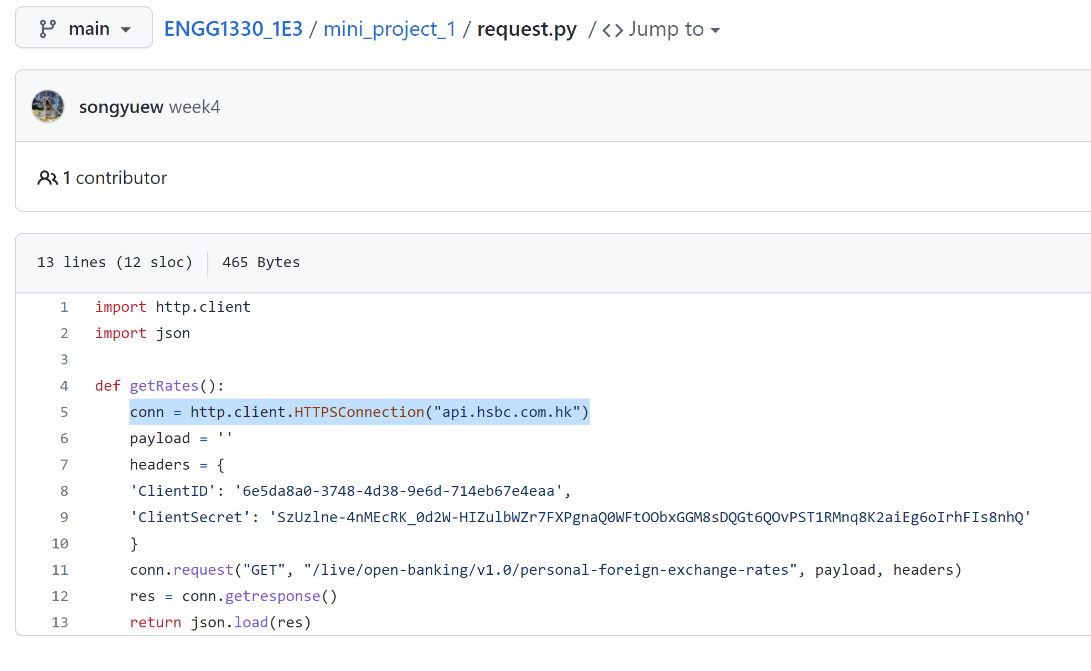
Case 1

Slide 4
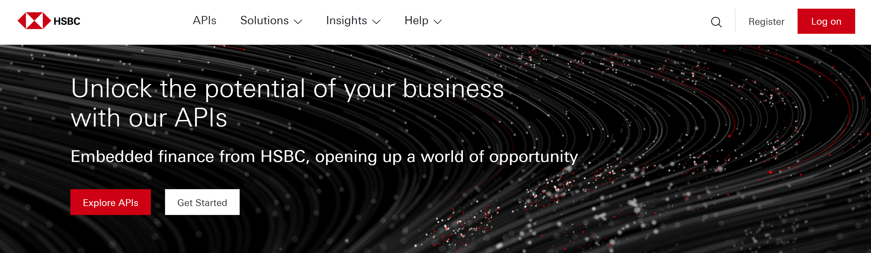
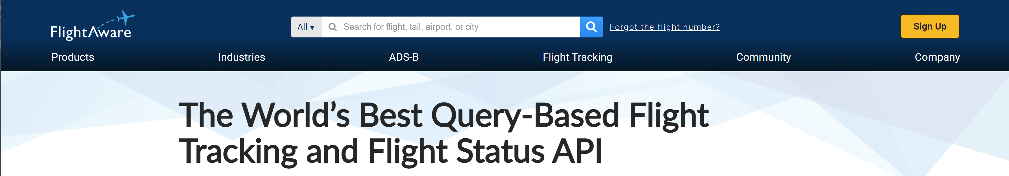
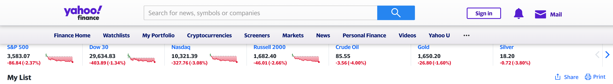
“Siri, give me the exchange rate between HKD and USD…”
“Siri, book a flight to London Heathrow…”
“Siri, quote me the price for one Tencent share…”
How Siri / Amazon Echo / Google Assistant get their data?

Slide 5
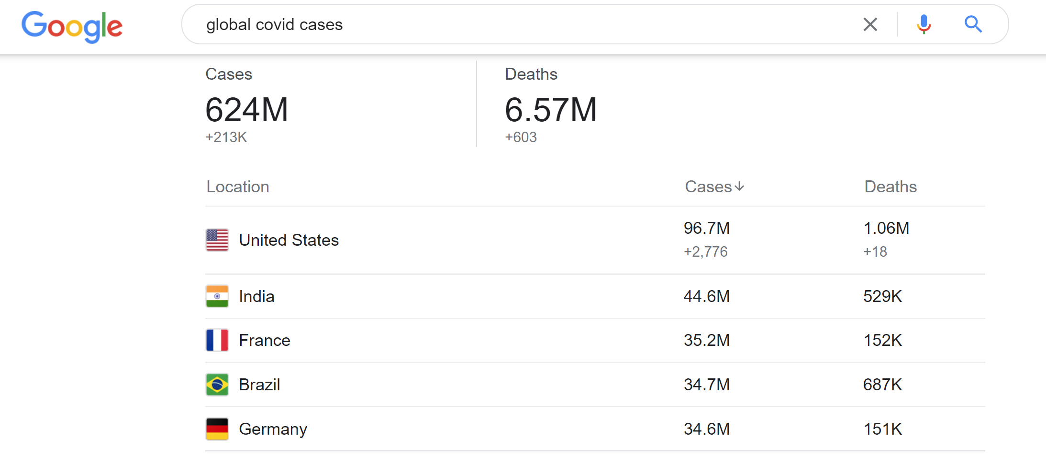
Case 2
National Health Commission – P. R. China
Centre of Health Protection – HKSAR
Centre of Disease Control – USA
National Health Service – UK
Ministère de la Santé et de la Prévention – France
...
How to get the information from all these authorities?

Slide 6
Legal, but emmm…
Ticket bot
Sneaker bot
Captcha solver
…

Slide 7


Slide 8
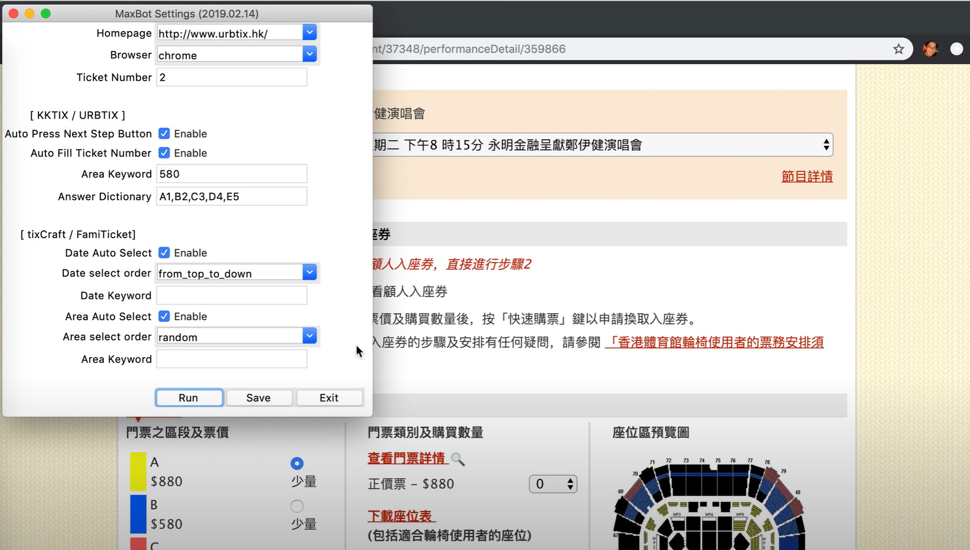

Slide 9
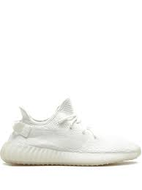
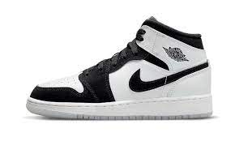

Slide 10
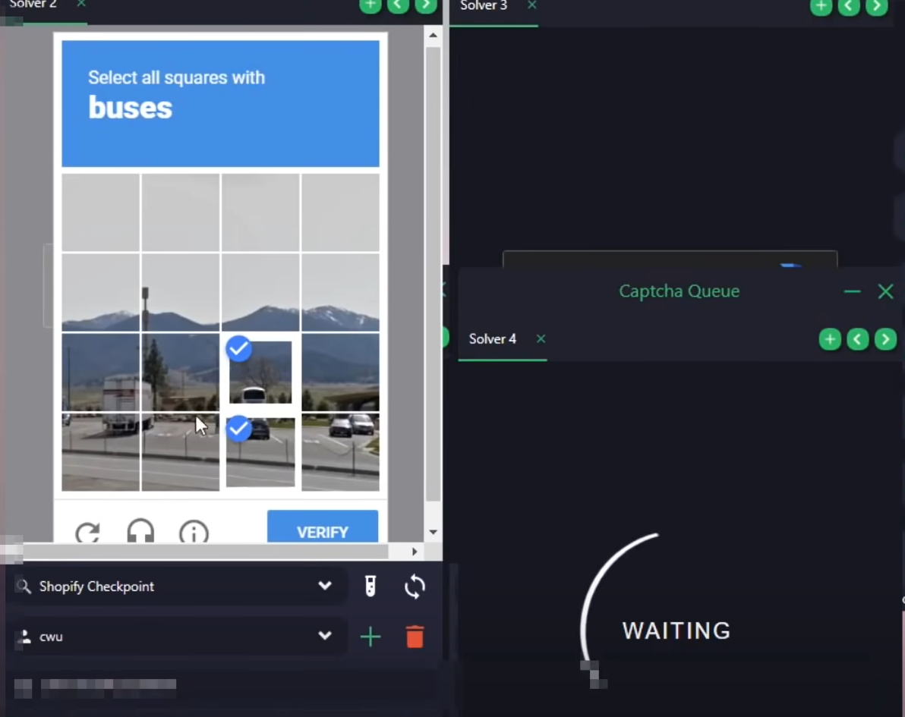

Slide 11
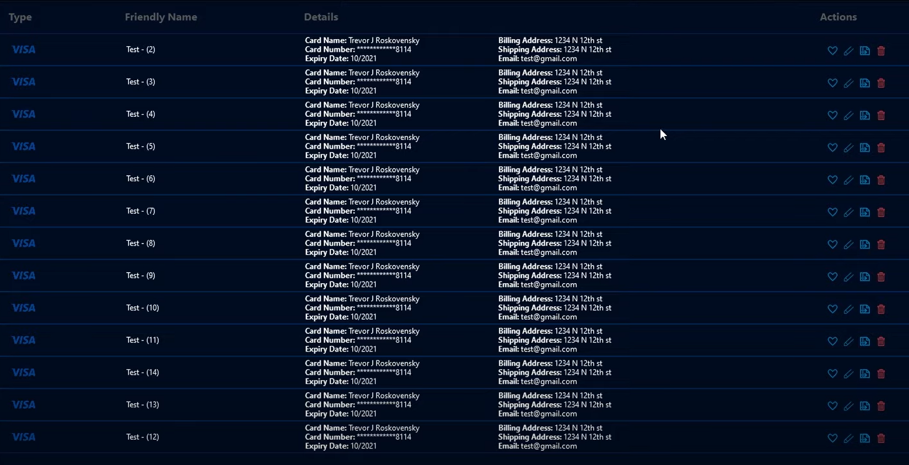

Slide 12
Don’t try!
Playing with public resources
Redistribute copyrighted contents with web crawler
High-speed crawling that may break the server (similar to DDOS)

Slide 13
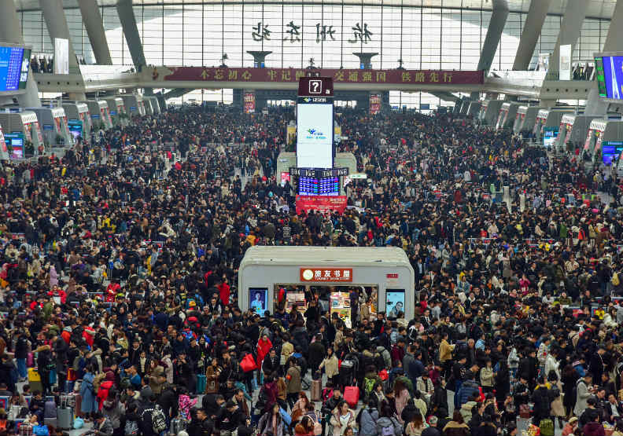
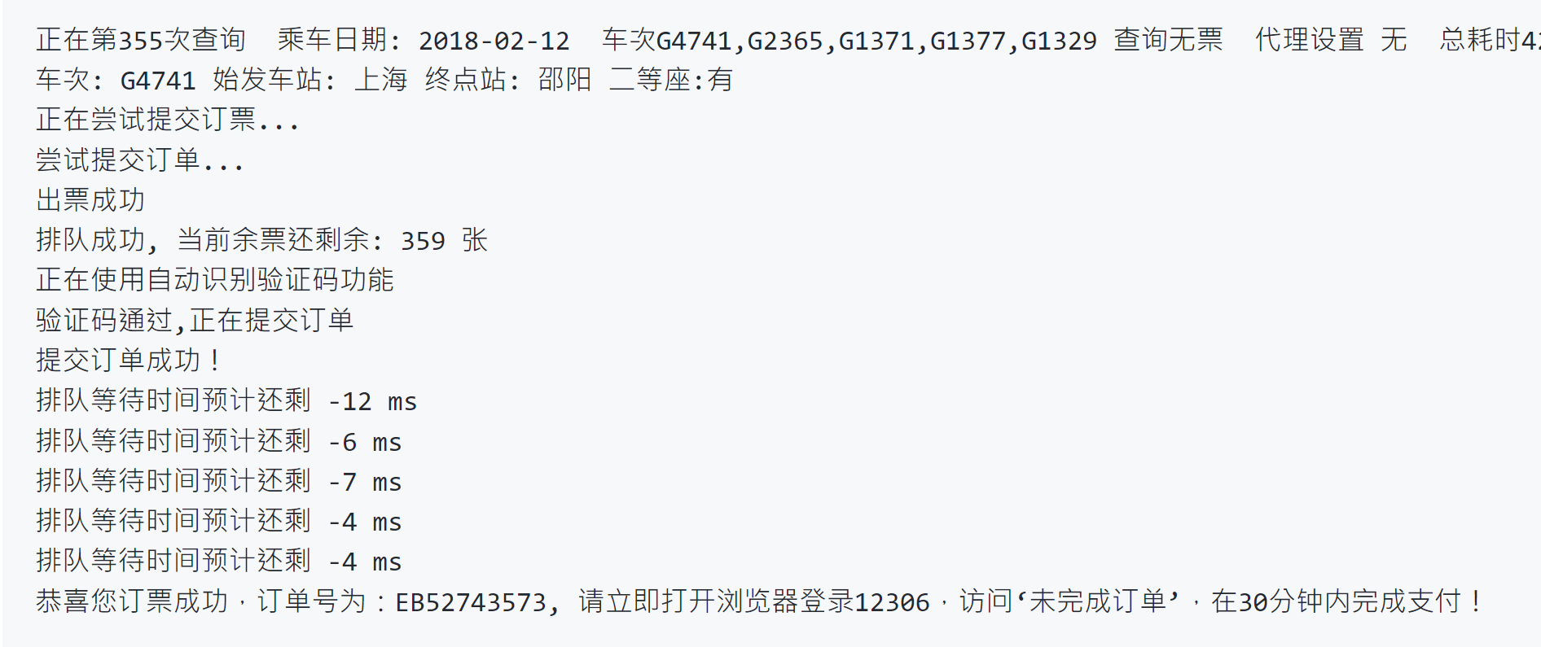

Slide 14
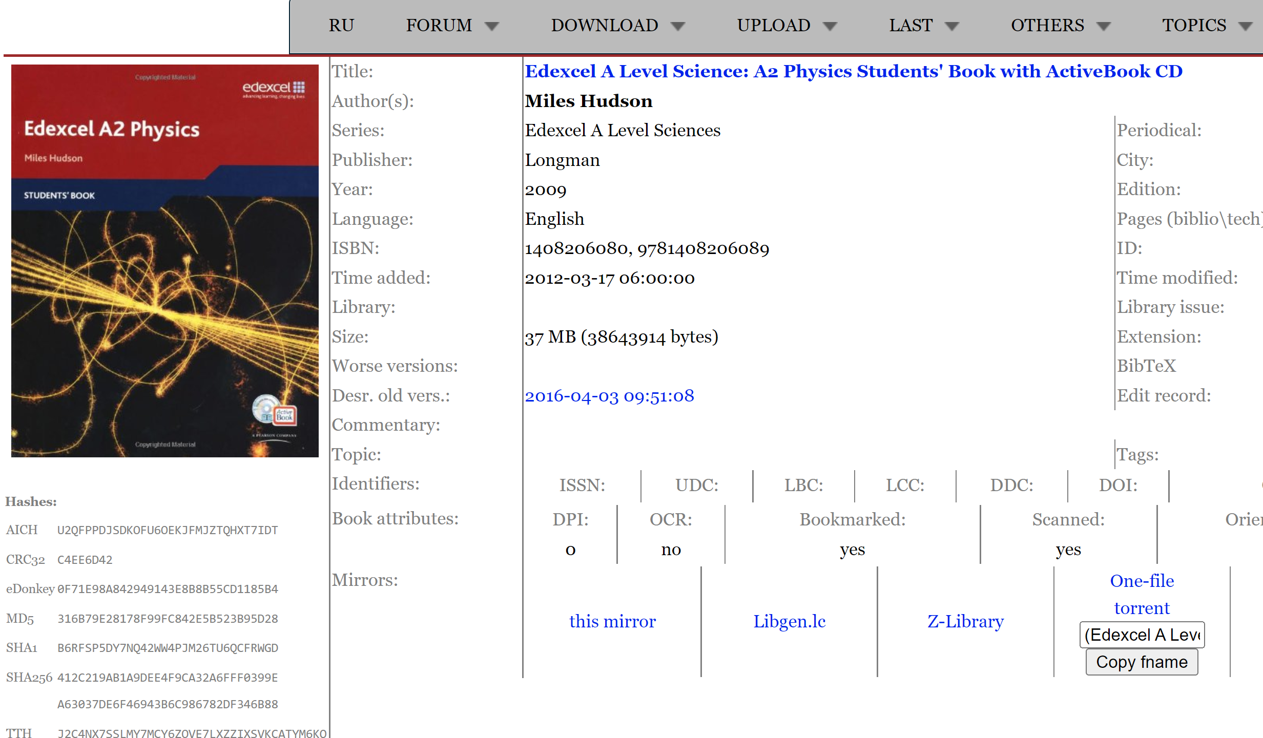

Slide 15
